Slide 1
Bloom filters

Slide 2
Bloom filters
Bloom filters is a data structure that allows to perform two operations:
Add new element into the data structure.
Test whether a given element is present.
All operations are performed with constant time complexity.
Bloom filters are called filters because they are often used as a cheap first pass to filter out segments of dataset that do not match query.

Slide 3
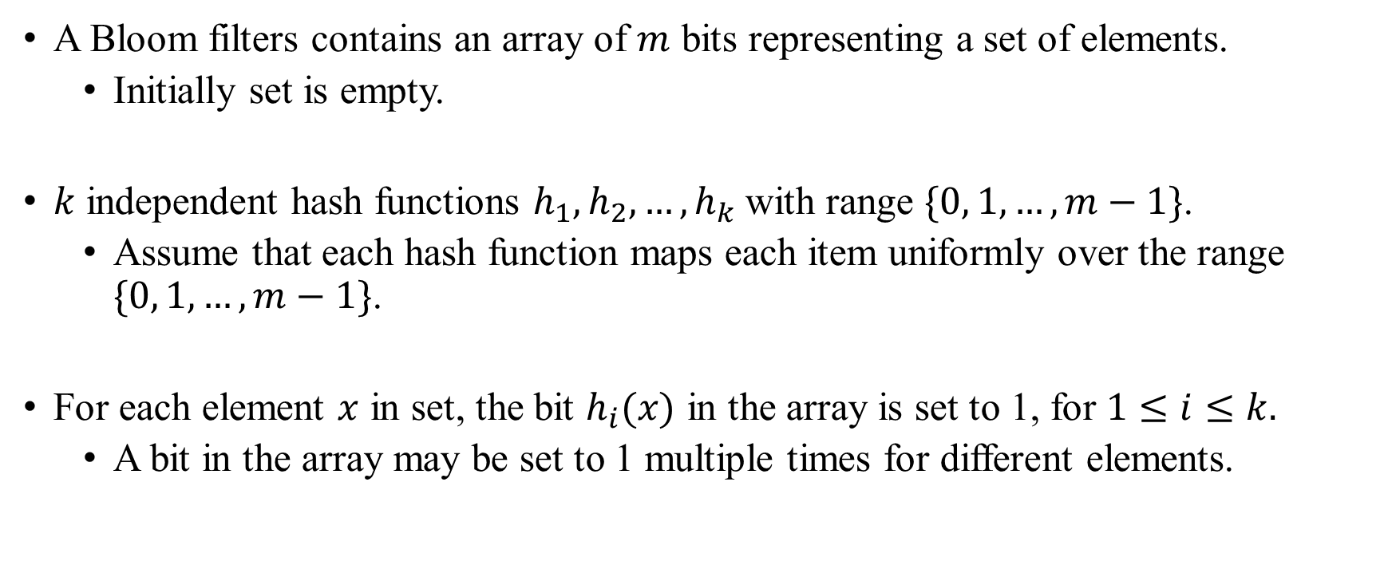
Bloom filters Inner representation
A Bloom filters contains an array of $m$ bits representing a set of elements.
Initially set is empty.
$k$ independent hash functions $h_{1}, h_{2}, …, h_{k}$with range $\{0, 1, …, m−1\}$.
Assume that each hash function maps each item uniformly over the range $\{0, 1, …, m−1\}$.
For each element $x$ in set, the bit $h_{i}(x)$ in the array is set to 1, for $1≤i≤k.$
A bit in the array may be set to 1 multiple times for different elements.

Slide 4
Bloom filters Operations
The bloom filters supports two operations: add and query.
Query is used to check whether a given element is in the set or not:
Returns false, if the element is definitely not in the set
Returns true, if the element is probably in the set
Add simply adds an element to the set.
Removal is impossible, but there are versions where deletion is possible, e.g. counting filters.

Slide 5

Bloom filters Operations: Add element
For a given element $x$ need to find $b_{1}=h_{1}\left(x\right), b_{2}=h_{2}\left(x\right), …, b_{k}=h_{k}\left(x\right).$
Set $b_{1}, b_{2}, …, b_{k}$ bits of internal array to 1.

Slide 6

Bloom filters Operations: Test element
For a given element $x$ need to find $b_{1}=h_{1}\left(x\right), b_{2}=h_{2}\left(x\right), …, b_{k}=h_{k}\left(x\right).$
Check $b_{1}, b_{2}, …, b_{k}$ bits of internal array:
If all the bits are equals to 1, then element is probably present in the filter.
Else, then element is definitely not present in the filter.

Slide 7

Bloom filters Example
Suppose that internal array size is equal to 20, and number of hash functions is 6:
Let’s add some element $x$:
So let’s suppose ${ h}_{1}\left(x\right)=2, h_{2}\left(x\right)=12,h_{3}\left(x\right)=4, h_{4}\left(x\right)=19,h_{5}\left(x\right)=1, h_{6}\left(x\right)=7$.
index | 0 | 1 | 2 | 3 | 4 | 5 | 6 | 7 | 8 | 9 | 10 | 11 | 12 | 13 | 14 | 15 | 16 | 17 | 18 | 19
value | 0 | 0 | 0 | 0 | 0 | 0 | 0 | 0 | 0 | 0 | 0 | 0 | 0 | 0 | 0 | 0 | 0 | 0 | 0 | 0

Slide 8
Bloom filters Example
Suppose that internal array size is equal to 20, and number of hash functions is 6:
Let’s add some element $x$:
So let’s suppose ${ h}_{1}\left(x\right)=2, h_{2}\left(x\right)=12,h_{3}\left(x\right)=4, h_{4}\left(x\right)=19,h_{5}\left(x\right)=1, h_{6}\left(x\right)=7$.
index | 0 | 1 | 2 | 3 | 4 | 5 | 6 | 7 | 8 | 9 | 10 | 11 | 12 | 13 | 14 | 15 | 16 | 17 | 18 | 19
value | 0 | 0 | 0 | 0 | 0 | 0 | 0 | 0 | 0 | 0 | 0 | 0 | 0 | 0 | 0 | 0 | 0 | 0 | 0 | 0

Slide 9
Bloom filters Example
Suppose that internal array size is equal to 20, and number of hash functions is 6:
Let’s add some element $x$:
So let’s suppose ${ h}_{1}\left(x\right)=2, h_{2}\left(x\right)=12,h_{3}\left(x\right)=4, h_{4}\left(x\right)=19,h_{5}\left(x\right)=1, h_{6}\left(x\right)=7$.
index | 0 | 1 | 2 | 3 | 4 | 5 | 6 | 7 | 8 | 9 | 10 | 11 | 12 | 13 | 14 | 15 | 16 | 17 | 18 | 19
value | 0 | 1 | 1 | 0 | 1 | 0 | 0 | 1 | 0 | 0 | 0 | 0 | 1 | 0 | 0 | 0 | 0 | 0 | 0 | 1

Slide 10

Bloom filters Example
Suppose that internal array size is equal to 20, and number of hash functions is 6:
Let’s add some element $y$:
So let’s suppose ${ h}_{1}\left(y\right)=3, h_{2}\left(y\right)=17,h_{3}\left(y\right)=10, h_{4}\left(y\right)=4,h_{5}\left(y\right)=5, h_{6}\left(y\right)=12$.
index | 0 | 1 | 2 | 3 | 4 | 5 | 6 | 7 | 8 | 9 | 10 | 11 | 12 | 13 | 14 | 15 | 16 | 17 | 18 | 19
value | 0 | 1 | 1 | 0 | 1 | 0 | 0 | 1 | 0 | 0 | 0 | 0 | 1 | 0 | 0 | 0 | 0 | 0 | 0 | 1

Slide 11
Bloom filters Example
Suppose that internal array size is equal to 20, and number of hash functions is 6:
Let’s add some element $y$:
So let’s suppose ${ h}_{1}\left(y\right)=3, h_{2}\left(y\right)=17,h_{3}\left(y\right)=10, h_{4}\left(y\right)=4,h_{5}\left(y\right)=5, h_{6}\left(y\right)=12$.
index | 0 | 1 | 2 | 3 | 4 | 5 | 6 | 7 | 8 | 9 | 10 | 11 | 12 | 13 | 14 | 15 | 16 | 17 | 18 | 19
value | 0 | 1 | 1 | 0 | 1 | 0 | 0 | 1 | 0 | 0 | 0 | 0 | 1 | 0 | 0 | 0 | 0 | 0 | 0 | 1

Slide 12

Bloom filters Example
Suppose that internal array size is equal to 20, and number of hash functions is 6:
Let’s add some element $y$.
So let’s suppose ${ h}_{1}\left(y\right)=3, h_{2}\left(y\right)=17,h_{3}\left(y\right)=10, h_{4}\left(y\right)=4,h_{5}\left(y\right)=5, h_{6}\left(y\right)=12$.
index | 0 | 1 | 2 | 3 | 4 | 5 | 6 | 7 | 8 | 9 | 10 | 11 | 12 | 13 | 14 | 15 | 16 | 17 | 18 | 19
value | 0 | 1 | 1 | 1 | 1 | 1 | 0 | 1 | 0 | 0 | 1 | 0 | 1 | 0 | 0 | 0 | 0 | 1 | 0 | 1

Slide 13

Bloom filters Example
Suppose that internal array size is equal to 20, and number of hash functions is 6:
Now, let’s test some element $z$.
So let’s suppose ${ h}_{1}\left(z\right)=7, h_{2}\left(z\right)=19,h_{3}\left(z\right)=10, h_{4}\left(z\right)=6,h_{5}\left(z\right)=4, h_{6}\left(z\right)=13$.
index | 0 | 1 | 2 | 3 | 4 | 5 | 6 | 7 | 8 | 9 | 10 | 11 | 12 | 13 | 14 | 15 | 16 | 17 | 18 | 19
value | 0 | 1 | 1 | 1 | 1 | 1 | 0 | 1 | 0 | 0 | 1 | 0 | 1 | 0 | 0 | 0 | 0 | 1 | 0 | 1

Slide 14
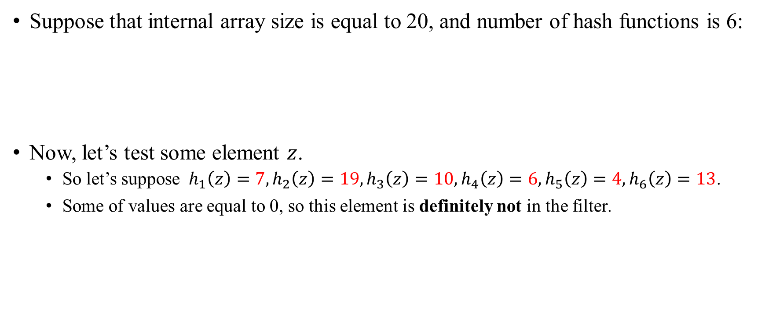
Bloom filters Example
Suppose that internal array size is equal to 20, and number of hash functions is 6:
Now, let’s test some element $z$.
So let’s suppose ${ h}_{1}\left(z\right)=7, h_{2}\left(z\right)=19,h_{3}\left(z\right)=10, h_{4}\left(z\right)=6,h_{5}\left(z\right)=4, h_{6}\left(z\right)=13$.
Some of values are equal to 0, so this element is definitely not in the filter.
index | 0 | 1 | 2 | 3 | 4 | 5 | 6 | 7 | 8 | 9 | 10 | 11 | 12 | 13 | 14 | 15 | 16 | 17 | 18 | 19
value | 0 | 1 | 1 | 1 | 1 | 1 | 0 | 1 | 0 | 0 | 1 | 0 | 1 | 0 | 0 | 0 | 0 | 1 | 0 | 1

Slide 15

Bloom filters Example
Suppose that internal array size is equal to 20, and number of hash functions is 6:
Also let’s test some element $w$.
So let’s suppose ${ h}_{1}\left(w\right)=17, h_{2}\left(w\right)=3,h_{3}\left(w\right)=12, h_{4}\left(w\right)=2,h_{5}\left(w\right)=10, h_{6}\left(w\right)=7$.
index | 0 | 1 | 2 | 3 | 4 | 5 | 6 | 7 | 8 | 9 | 10 | 11 | 12 | 13 | 14 | 15 | 16 | 17 | 18 | 19
value | 0 | 1 | 1 | 1 | 1 | 1 | 0 | 1 | 0 | 0 | 1 | 0 | 1 | 0 | 0 | 0 | 0 | 1 | 0 | 1

Slide 16
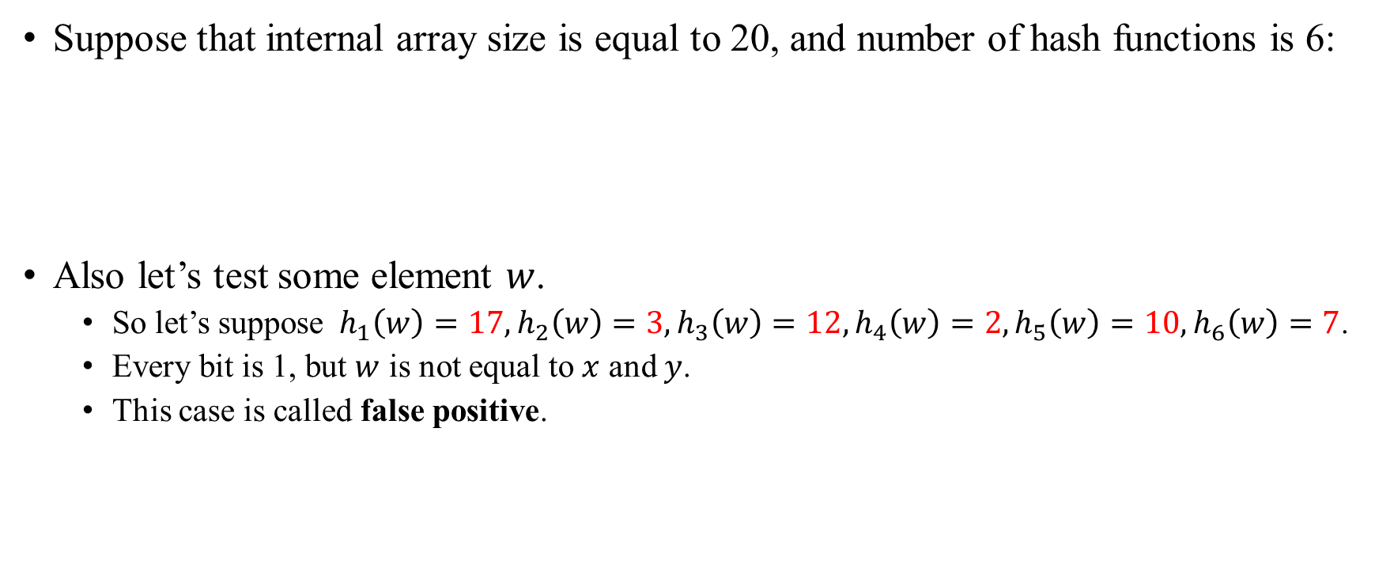
Bloom filters Example
Suppose that internal array size is equal to 20, and number of hash functions is 6:
Also let’s test some element $w$.
So let’s suppose ${ h}_{1}\left(w\right)=17, h_{2}\left(w\right)=3,h_{3}\left(w\right)=12, h_{4}\left(w\right)=2,h_{5}\left(w\right)=10, h_{6}\left(w\right)=7$.
Every bit is 1, but $w$ is not equal to $x$ and $y$.
This case is called false positive.
index | 0 | 1 | 2 | 3 | 4 | 5 | 6 | 7 | 8 | 9 | 10 | 11 | 12 | 13 | 14 | 15 | 16 | 17 | 18 | 19
value | 0 | 1 | 1 | 1 | 1 | 1 | 0 | 1 | 0 | 0 | 1 | 0 | 1 | 0 | 0 | 0 | 0 | 1 | 0 | 1

Slide 17
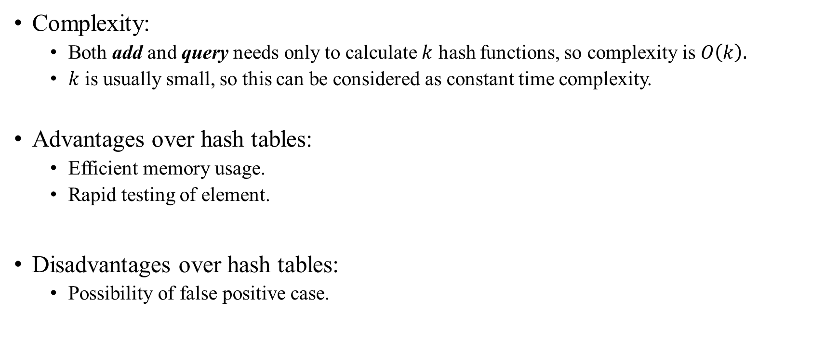
Bloom filters Summary
Complexity:
Both add and query needs only to calculate $k$ hash functions, so complexity is $O\left(k\right).$
$k$ is usually small, so this can be considered as constant time complexity.
Advantages over hash tables:
Efficient memory usage.
Rapid testing of element.
Disadvantages over hash tables:
Possibility of false positive case.

